Slide 1

Dynamic Web App for E-commerce
Group 21:
Harpinder Kaur Brar
Judit Johnson Thomas
Baasanlkham Gurvantamir

Slide 2
Lane-wood Clothing
“Fashion that inspires confidence”
We are representing an e-commerce webapp focusing on inventory management. At Lane-Wood Clothing, we do not only sell clothes but also simplify the inventory management process using database, making it to track and manage products.
Our website offers a range of user-friendly features, including filtering options for users with intuitive dashboards.

Slide 3
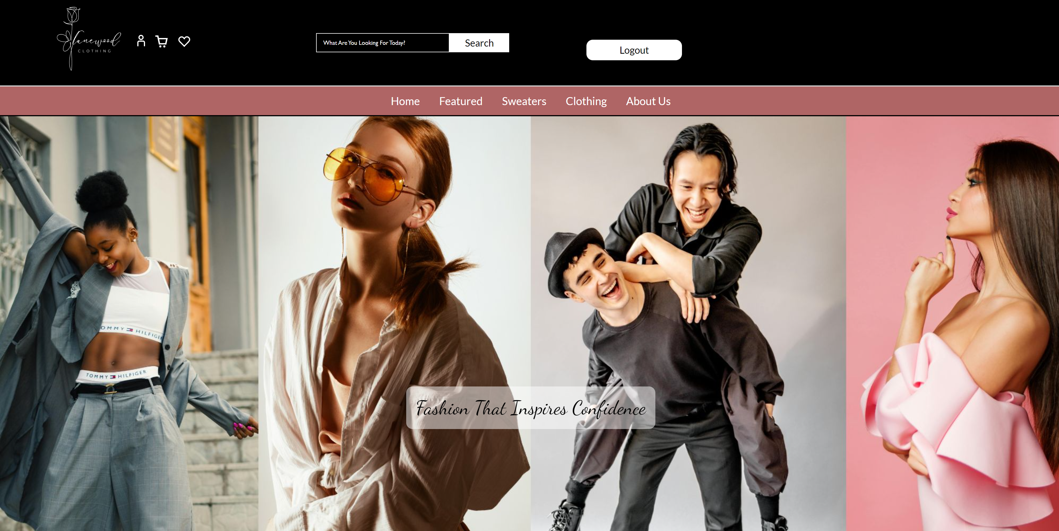
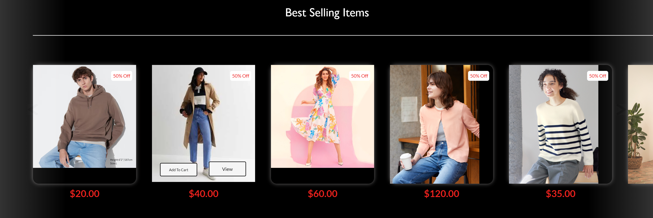
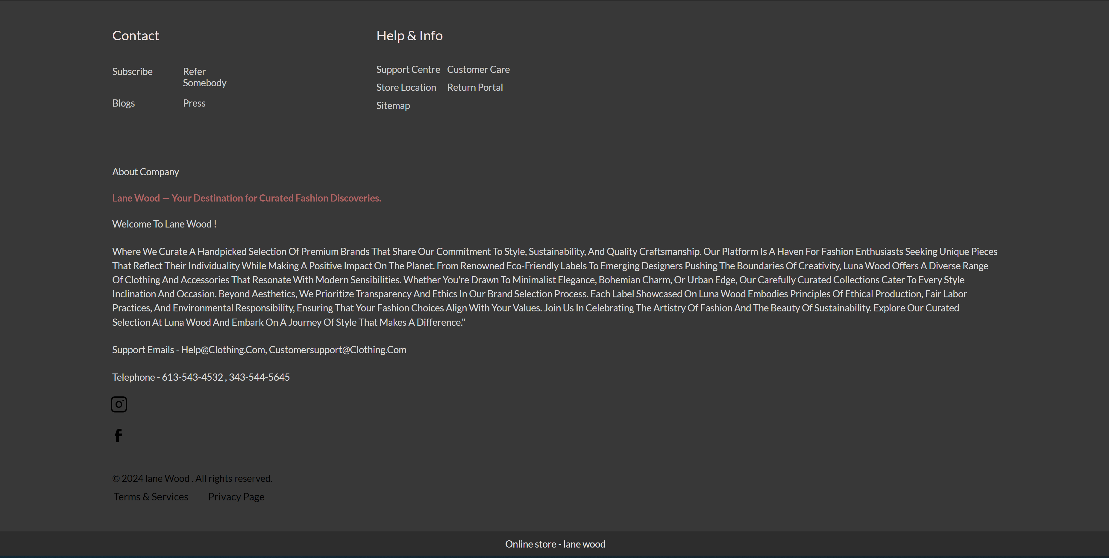
Quick Preview of UI

Slide 4
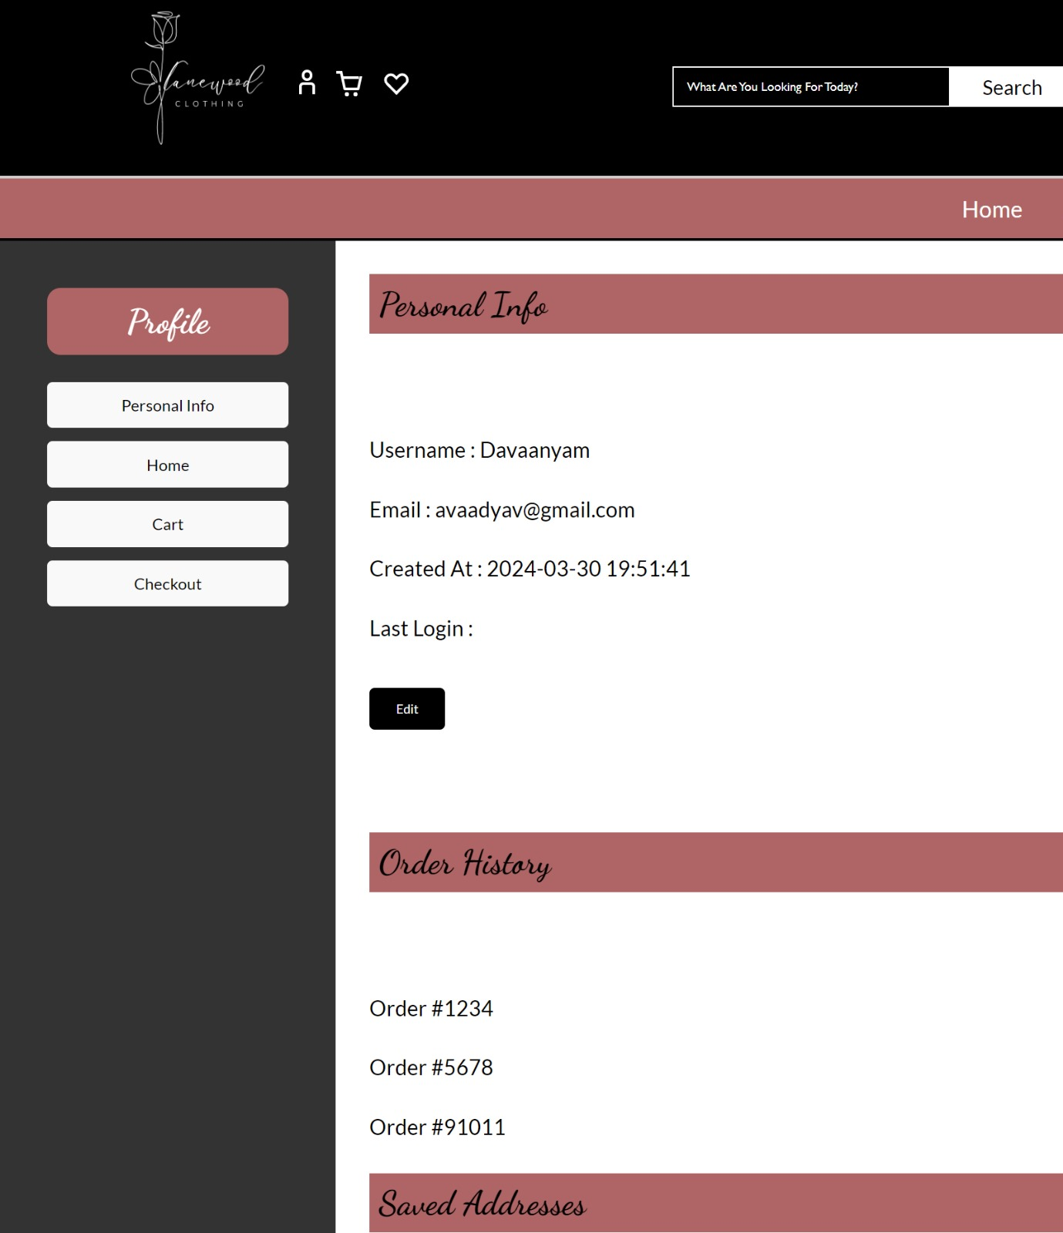
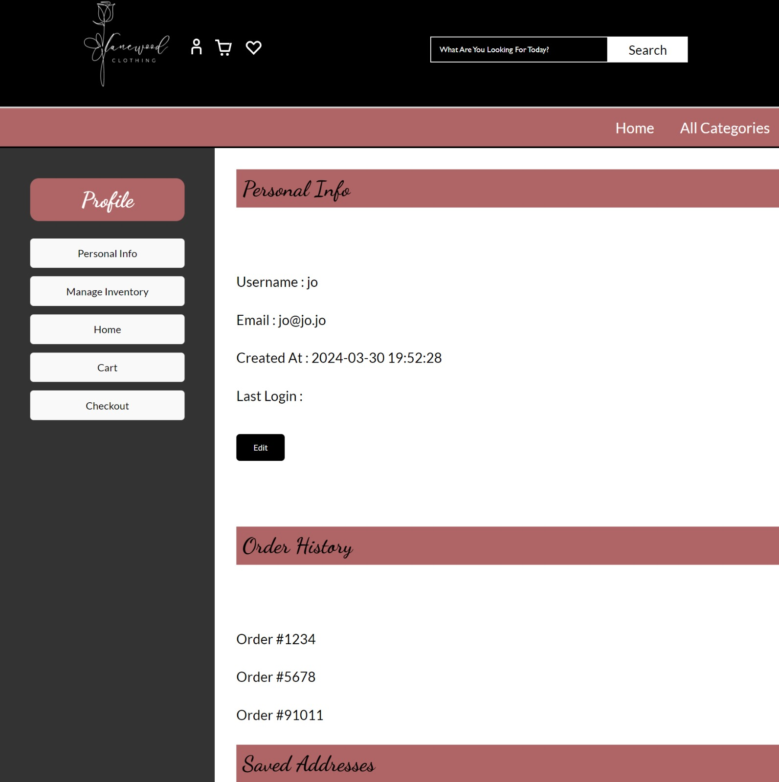
Client and Admin Profile

Slide 5
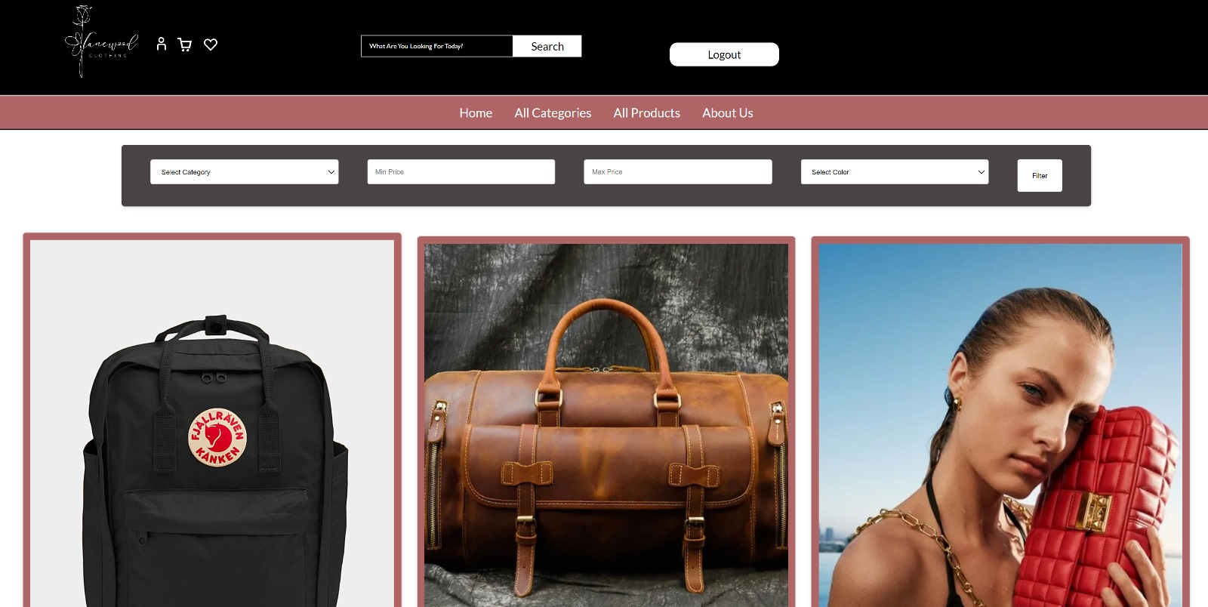
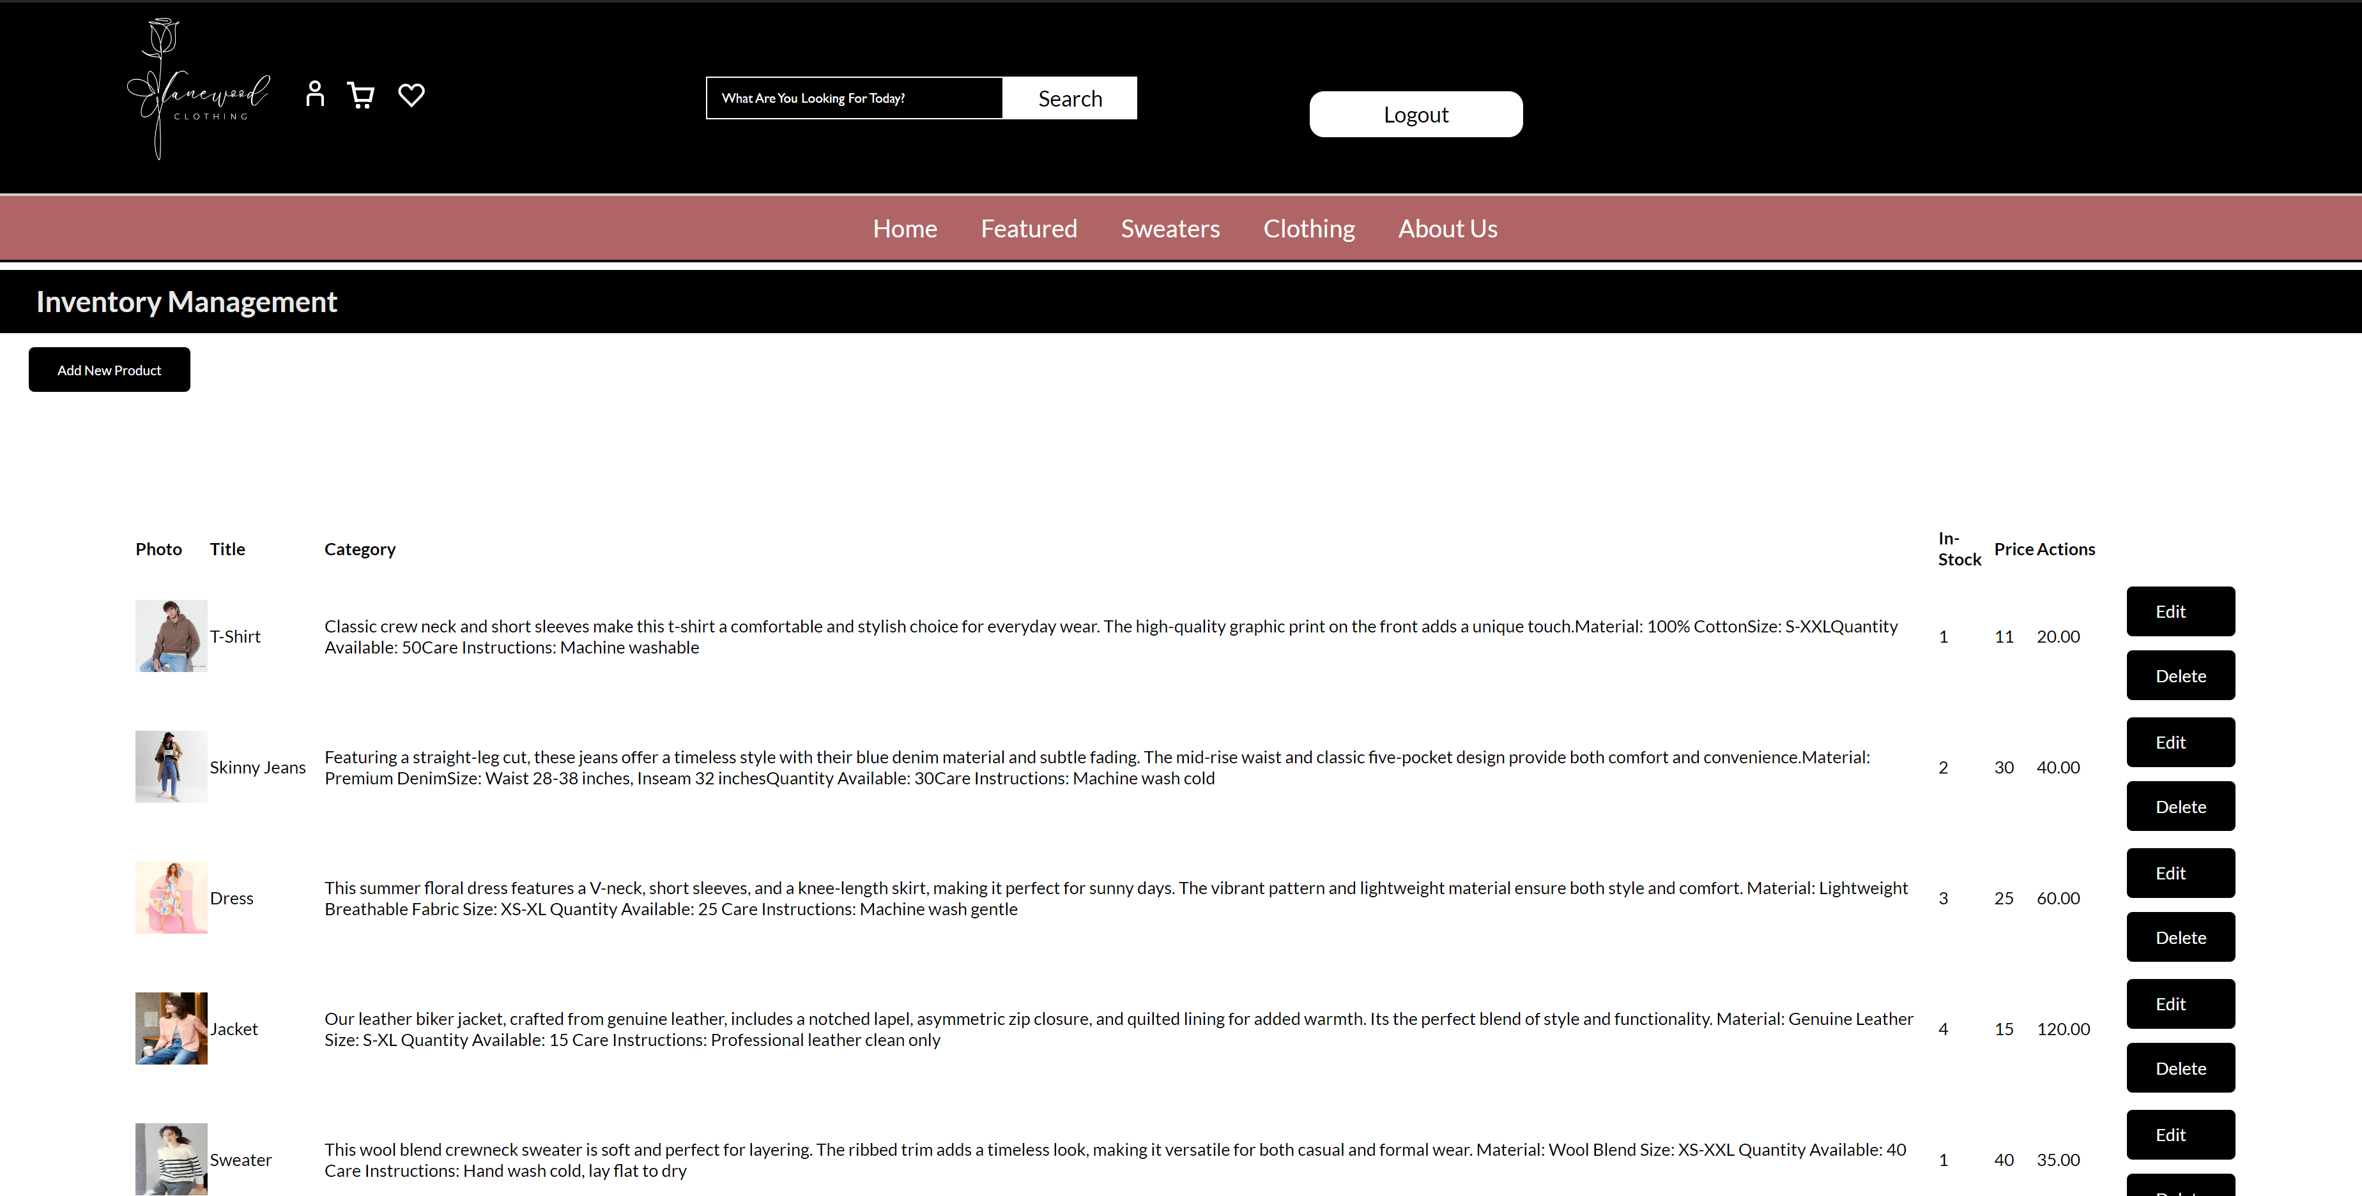
Features

Slide 6

Features
Database Management System: A robust backend for efficient inventory tracking.
User-Friendly Interface: Intuitive dashboards for an enhanced user experience.
Role Distinction: Customized features for users and clients, including profile editing and inventory management.
Admin Privileges: Comprehensive control over product management."
Filtering Options: Simplified product searches for users.

Slide 7
Conclusion
In conclusion, Lane Wood Clothing provides a user-friendly platform for both shoppers and businesses with easy inventory management and convenient shopping features, Whether you're browsing for the latest styles or managing your inventory.

Slide 8
Thank you! We're open to questions and further discussions

